Slide 1
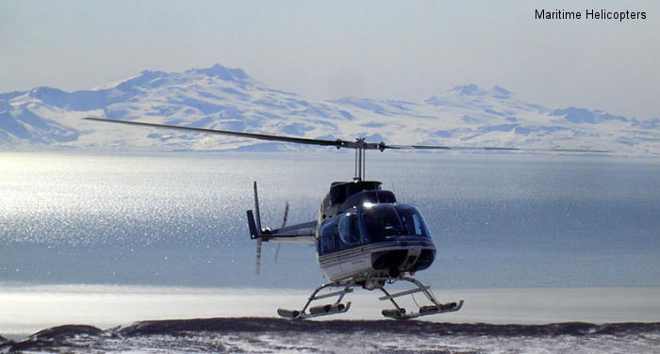
INITIAL TRAINING PROGRAM
MARITIME HELICOPTERS TRAINING
Company Introduction
Established in 1973
Alaskan-Owned and Operated for 42 years

Slide 2
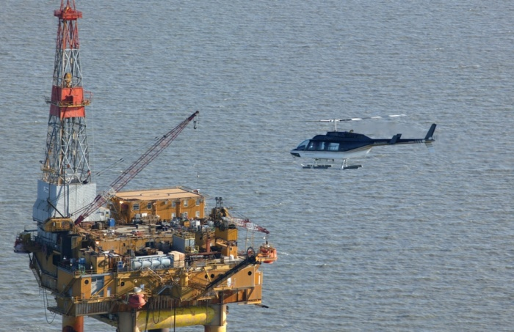
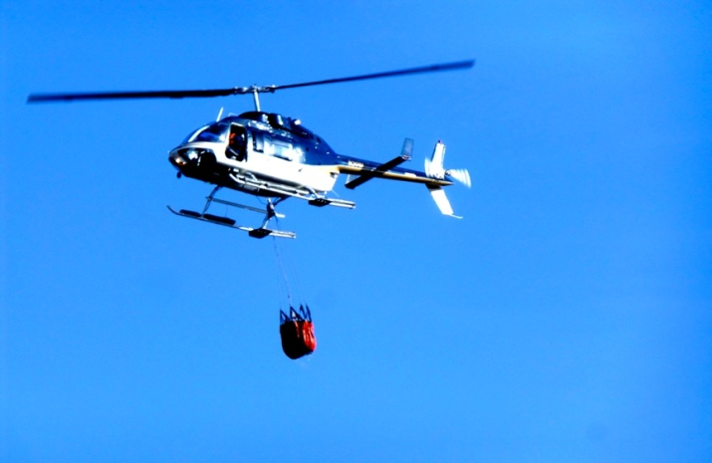
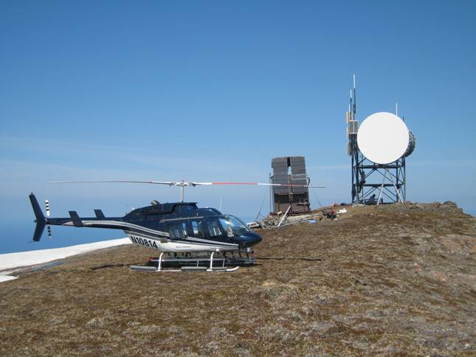
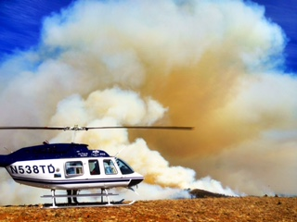
INITIAL TRAINING PROGRAM
MARITIME HELICOPTERS TRAINING
Utility - Many Missions
Oil Exploration
Sling Load Operations
Forestry Service

Slide 3
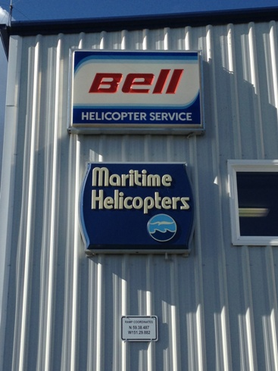
INITIAL TRAINING PROGRAM
MARITIME HELICOPTERS TRAINING
Bell Helicopters Approved Service Center. – Only one in the State of Alaska
FAA Part 145 Repair Station
FAA Satellite Repair Station
FAA Part 133 Approved
FAA Part 135 Approved
FAA Part 137 Approved
15 Helicopters and growing….

Slide 4
INITIAL TRAINING PROGRAM
MARITIME HELICOPTERS TRAINING
  Bases/Locations
  Fairbanks Valdez
  Kenai Homer (Main Base)
  Kodiak Akutan
    Various Pump Stations
  North Slope to tip of Aleutian Chain

Slide 5
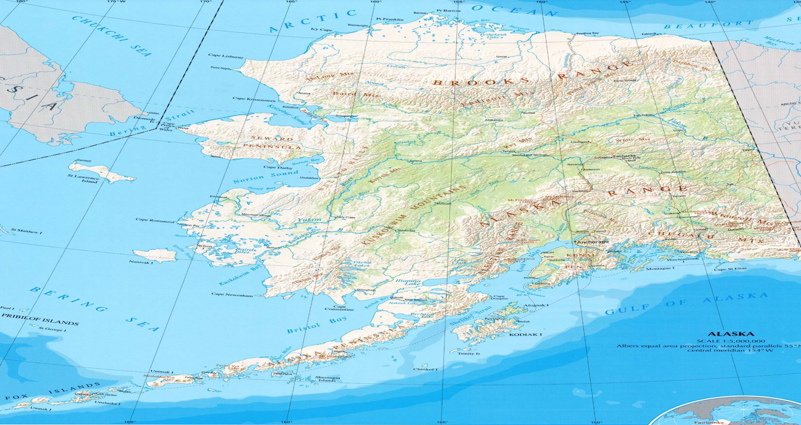
INITIAL TRAINING PROGRAM
MARITIME HELICOPTERS TRAINING

Slide 6
INITIAL TRAINING PROGRAM
MARITIME HELICOPTERS TRAINING
  Part 145 Repair Stations
Homer – Main Part 145 Repair Station
Fairbanks – Satellite Part 145 Repair Station
NDT approved

Slide 7
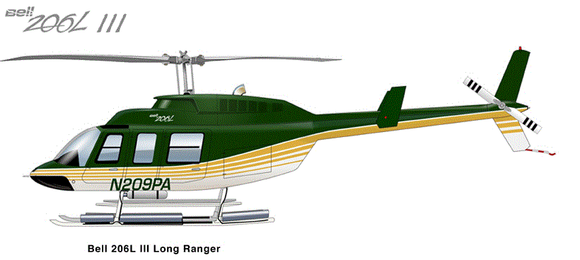
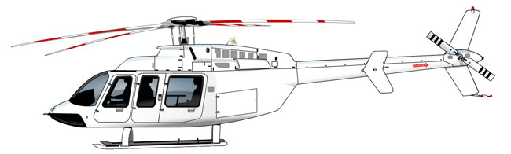

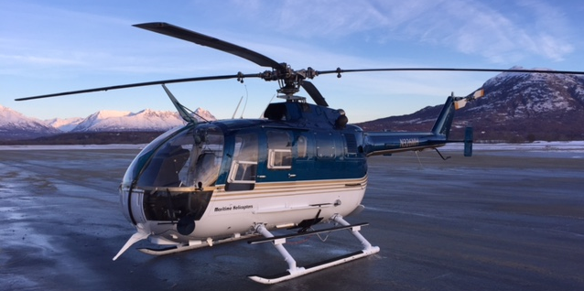
INITIAL TRAINING PROGRAM
MARITIME HELICOPTERS TRAINING
Bell 206 L Series
Bell 407
Bell 412HP
BO-105

Slide 8
INITIAL TRAINING PROGRAM
MARITIME HELICOPTERS TRAINING
Administration
Operations
Maintenance
Human Resources
Part 135
Part 145 Repair Station
Safety
Part 145
Part 135
DOM
Repair Station
Satellite Repair Station
DOO
DOM
Mechanics
Chief Pilot
Pilots

Slide 9
INITIAL TRAINING PROGRAM
MARITIME HELICOPTERS TRAINING
AntiDrug and Alcohol Misuse Prevention
All Maritime Helicopter Mechanics and Pilots must be under the FAA mandatory Drug and Alcohol Program. I/A/W 14 CFR Part 120 and 49 CFR Part 40.
Testing Required
Pre-Employment Random
Reasonable Cause Return to Duty
Post-Accident Follow-Up

Slide 10
INITIAL TRAINING PROGRAM
MARITIME HELICOPTERS TRAINING
Safety Program - Policy
Maritime Helicopters objective is to provide the healthiest, safest environmentally sustainable workplace with the highest standards of quality and service to our customers, and to constantly strive to improve these standards, thereby maintaining our position as a leading provider of helicopter and associated support services.
The Maritime Helicopters Board and everyone employed throughout the group is responsible for ensuring the wellbeing of themselves and exercising a duty of care to others by operating appropriately and demonstrating compliance with this policy, the associated regulatory requirements, company processes and procedures at all times.
Good Safety performance is critical to the success of our business and our goals are simply stated;

Slide 11

INITIAL TRAINING PROGRAM
MARITIME HELICOPTERS TRAINING
Safety Program
Maritime Helicopters Health, Safety and Environmental (HSE) Manual can be found on the Maritime Helicopters Maintenance Portal under SAFETY .
http://www.rotor-apps.com/MHI/safety3.html

Slide 12
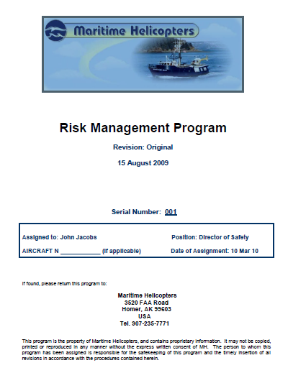
INITIAL TRAINING PROGRAM
MARITIME HELICOPTERS TRAINING
Safety Program
Maritime Helicopters Risk Management Manual can be found on the Maritime Helicopters Maintenance Portal under SAFETY .
http://www.rotor-apps.com/MHI/safety2.html

Slide 13
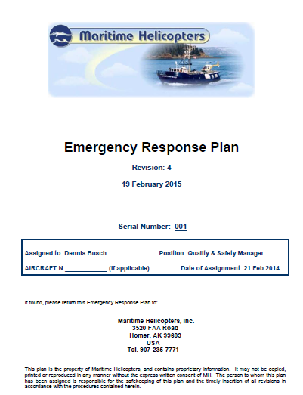
INITIAL TRAINING PROGRAM
MARITIME HELICOPTERS TRAINING
Safety Program
Maritime Helicopters Emergency Response Plan can be found on the Maritime Helicopters Maintenance Portal under SAFETY .
http://www.rotor-apps.com/MHI/safety5.html

Slide 14
INITIAL TRAINING PROGRAM
MARITIME HELICOPTERS TRAINING
Safety Program
Accident and Incident Reporting
All accident and incidents shall be reported and a form completed depending if the accident /incident occurred on the ground or in the air.
Forms my be obtains from the MHI Quality and Safety Manager.
Forms include the following -
  Ground Occurrence Report
  Flight Irregularity Report

Slide 15
INITIAL TRAINING PROGRAM
MARITIME HELICOPTERS TRAINING
Forms and Records
  Log Books – Located in aircraft. All maintenance performed on MHI aircraft shall have a logbook entry and 43.9/11 sign off returning the aircraft to service.
  Form 337 – Used any time there is a modification to the aircraft that affects it’s original Type Certificate.
  Component Cards – Maintained in the Homer and Fairbanks maintenance offices. The card are usually only filled out by the DOM, Fairbanks Maintenance Manager or Chief Inspectors.
  Tags – Any items removed from an aircraft shall be tagged either by placing the appropriated Red, Green or Yellow tag on the component or during inspections, or tag the table where the parts from the aircraft are temporarily placed.

Slide 16
INITIAL TRAINING PROGRAM
MARITIME HELICOPTERS TRAINING
Maintenance Concepts
Operations Specifications - Basically a contract between the FAA and the operator. It grants permission for the Air Carrier and/or Repair Station to operate under specific approvals and guidelines.
The “OpSpecs” are created either by the FAA or Air Carrier and must be signed by both the FAA and the carrier before they are issued.
They are updated as operations change with the operator such as going from VFR to adding IFR.
They are divided into under the CFR they regulate such as Part 133,
137, 135 and Part 145. Each is further divided into Part A, B and D depending on what is addressed i.e. management, operations, maintenance, aircraft listing, MEL, etc.

Slide 17
INITIAL TRAINING PROGRAM
MARITIME HELICOPTERS TRAINING
Maintenance Concepts
Daily Inspections - All aircraft will have an Airworthiness Check performed by a company mechanic in accordance with the applicable Maintenance Manual. This shall be performed on days the aircraft is in service, after the last flight or before the first fight of the day. When a Airworthiness Check has been completed, the mechanic shall place a green sock over the cyclic indicating to the pilot the check has been performed.
It is expected that if a mechanic is physically present, this check shall be performed by the mechanic each flight day. The mechanic shall also meet with the duty pilot to review the Aircraft Status CALM Report to include any pen and ink changes to ensure awareness of items coming due. Pilots and mechanics must concur that all items coming due are noted on the Aircraft Status CALM Report and the Items Due section of the Aircraft Log Book.
If maintenance discrepancies are identified during the Airworthiness Check, an appropriate log book entry shall be made by the individual who made the discovery and an appropriately rated mechanic contacted to perform corrective action.
In the absence of a company mechanic, the pilots preflight shall be the equivalent of an aircraft Airworthiness Check. The pilot shall record the preflight / airworthiness check by signing the appropriate section of the Helicopter Log. The pilot shall utilize the preflight section of the appropriate approved Rotorcraft Flight Manual. This check shall include a review of the Aircraft Status CALM Report .

Slide 18
INITIAL TRAINING PROGRAM
MARITIME HELICOPTERS TRAINING
Maintenance Concepts
Preventative Maintenance – Defined as simple or minor preservation operations and the replacement of small standard parts not involving complex assembly operations.
Maritime Helicopters has an aggressive preventative maintenance program due to the type of environment we must operate in.

Slide 19
INITIAL TRAINING PROGRAM
MARITIME HELICOPTERS TRAINING
Maintenance Concepts
Component Overhaul Intervals – Overhauls are accomplished by a certified repair station, or other approved facilities in accordance with the aircraft, engine, or accessory manufacturers’ manual.
Each aircraft Maintenance Manual contains a table, which summarizes the overhaul schedule of the airframe and engine components and accessories.
No deviations to the retirement schedule contained in the airworthiness limitations section of the manufacturer's manuals.
Overhaul extensions may be requested thru the manufacturer and FAA. This will be done thru the DOM. (See MHI GMM Section B)
Overhaul intervals for each component are tracked on the company aircraft status report; CALM

Slide 20
INITIAL TRAINING PROGRAM
MARITIME HELICOPTERS TRAINING
Maintenance Concepts
Engine Overhaul Intervals – Overhauls of all MHI engines are generally accomplished thru the engine manufacturer approved facilities .
No deviations to the retirement schedule contained in the airworthiness limitations section of the manufacturer's manuals.
Overhaul intervals for each engine component are tracked on the company aircraft status report; CALM

Slide 21
INITIAL TRAINING PROGRAM
MARITIME HELICOPTERS TRAINING
Maintenance Concepts
Weight and Balance – All MHI aircraft must have a current weight and balance form on board to operate
The weight and balance form must reflect the current configuration of the aircraft.
All aircraft are weighed coming out of our annual inspections due to OAS requirements.
Weight and Balance intervals for aircraft are tracked on the individual aircraft status report; CALM

Slide 22
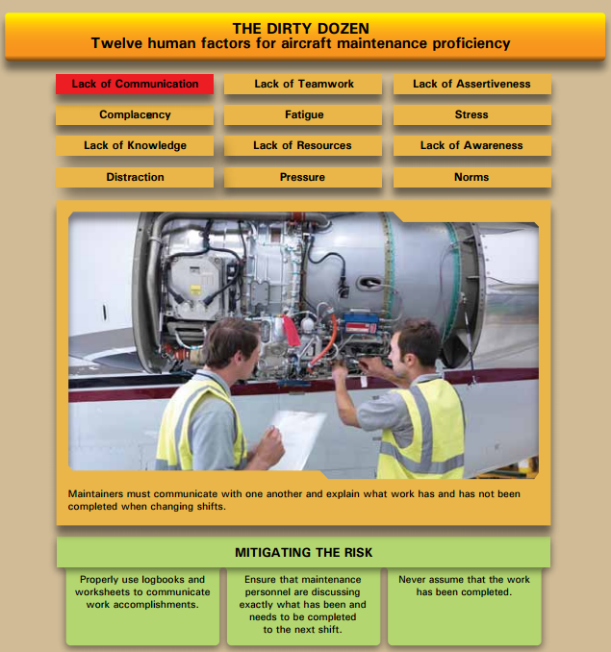
INITIAL TRAINING PROGRAM
MARITIME HELICOPTERS TRAINING
Human Factors

Slide 23
INITIAL TRAINING PROGRAM
MARITIME HELICOPTERS TRAINING
Human Factors
Distractions – Maritime Helicopters’ maintenance technicians are tasked with a myriad of responsibilities while performing aircraft maintenance. The requirements of daily operations, particularly time constraints, regulatory compliance, mission readiness, and fiscal concerns, can create distractions in maintenance routines and procedures. It is the maintenance technician’s responsibility to minimize distractions while performing maintenance on Maritime Helicopters’ aircraft.

Slide 24
INITIAL TRAINING PROGRAM
MARITIME HELICOPTERS TRAINING
Human Factors
Lack of Communication – Lack of communication is a key human factor that can result in suboptimal, incorrect, or faulty maintenance. Lack of communication between technicians could lead to a maintenance error and result in an aircraft accident. This is especially true during procedures where more than one technician performs the work on the aircraft.
Continuing a job that has been started by someone else should only occur after a face-to-face meeting of technicians. The applicable paperwork should be reviewed, the completed work discussed, and attention for the next step should be drawn. Absence of either a written or oral turnover serves as warning that an error could occur

Slide 25
INITIAL TRAINING PROGRAM
MARITIME HELICOPTERS TRAINING
Human Factors
Teamwork – In aviation maintenance, there will always be occasions when it is necessary to work long hours in order to maintain aircraft in an airworthy condition. It is expected that scheduled maintenance should be planned and accomplished without the need for long periods of extended work hours.
Closely related to lack of communication, teamwork is required in aviation maintenance in many instances. Sharing of knowledge between technicians, coordinating maintenance functions, turning work over from shift to shift, and working with flight personnel to troubleshoot and test aircraft are all are executed better in an atmosphere of teamwork.
Teams can win or lose depending on how well everyone in the organization works together toward a common objective. A lack of teamwork makes all jobs more difficult and, in maintenance, could result in a miscommunication that affects the airworthiness of the aircraft.

Slide 26
INITIAL TRAINING PROGRAM
MARITIME HELICOPTERS TRAINING
Human Factors
Stress – The causes of stress are referred to as stressors. They are categorized as physical, psychological, and physiological stressors. Following, is a list of each and how they may affect maintenance.
Physical; Temperature, Noise, Lighting, Confined Spaces
Psychological; Work, Finances, Marital, Interpersonal
Physiological; Illness, Poor Diet, Lack of Sleep, Shifting Schedules

Slide 27
INITIAL TRAINING PROGRAM
MARITIME HELICOPTERS TRAINING
Human Factors
Fatigue – In aviation maintenance, there will always be occasions when it is necessary to work long hours in order to maintain aircraft in an airworthy condition. It is expected that scheduled maintenance should be planned and accomplished without the need for long periods of extended work hours.
Mechanics must have adequate rest to ensure optimum performance when on duty. Personnel safety and aircraft airworthiness are our top priority.
It is expected that any mechanic who becomes aware that fatigue and/or stress have made it impossible for him or her to continue to perform maintenance in accordance with the standards required for airworthiness, will cease work and notify his or her immediate supervisor.
Likewise, it is the obligation of any individual supervising aircraft mechanics, to monitor the effects of extended work hours and stress (as well as environmental factors) on mechanics performance.

Slide 28
INITIAL TRAINING PROGRAM
MARITIME HELICOPTERS TRAINING
Human Factors
Complacency – Complacency is a human factor in aviation maintenance that typically develops over time. As a technician gains knowledge and experience, a sense of self satisfaction and false confidence may occur. A repetitive task, especially an inspection item, may be overlooked or skipped because the technician has performed the task a number of times without ever finding a fault. The false assumption that inspection of the item is not important may be made.
However, even if rare, a fault may exist. The consequences of the fault not being detected and corrected could cause an incident or accident. Routine tasks performed over and over allow time for the technician’s mind to wander, which may also result in a required task not being performed. When a technician finds him or herself performing work without documentation, or documenting work that was not performed, it is a sign that complacency may exist.

Slide 29
INITIAL TRAINING PROGRAM
MARITIME HELICOPTERS TRAINING
Human Factors
Cell Phones – The use of cellular phones while performing maintenance on Maritime Helicopters aircraft is prohibited.
Incoming phone calls shall be directed to voice mail and may be retrieved upon completion of the task.
Phone calls serve as a distraction and may cause the maintenance technician to miss a critical step during a maintenance procedure.
Calls may be made or received during lunch and break hours.

Slide 30
INITIAL TRAINING PROGRAM
MARITIME HELICOPTERS TRAINING
Human Factors
Health Concerns and Family/Relationship Problems
Additional distractions such as personal issues, work relationships and health concerns should be resolved prior to performing aircraft maintenance.
It is recommended that the maintenance technician contact his or her supervisor if issues exist that would serve as a distraction while performing aircraft maintenance.

Slide 31
INITIAL TRAINING PROGRAM
MARITIME HELICOPTERS TRAINING
Safety Standards
Maritime Helicopters is committed to the attainment of the highest level of safety in the accomplishment of our corporate mission. It is our goal to provide a safe and healthy working environment for all of our team members and, in doing so, to support state and federal laws regarding safety. Our intention in making this strong commitment is to eliminate injuries to our employees and accidental damage to equipment and/or property. It will be understood that team members of all levels of the company will be safety committee members.
The scope of the Maritime Helicopters’ safety program includes all aspects of company practice; in flight, in the performance of maintenance; on the ramps; on the helipads; in our offices and fire prevention in every environment in which we work.
Responsibility for implementing the safety program rests with the Maritime Helicopters Safety Officer, Officers, base and aviation safety managers, managers and supervisors at every level. That responsibility brings with it the obligation and authority to actively promote the safety program company-wide.

Slide 32
INITIAL TRAINING PROGRAM
MARITIME HELICOPTERS TRAINING
Personal Safety
Proper Clothing - Managers shall ensure that each affected employee uses appropriate eye or face protection when exposed to eye or face hazards from flying particles, molten metal, liquid chemicals, acids or caustic liquids, chemical gases or vapors, or potentially injurious light radiation.
Personal protective equipment (PPE) - Intended to protect, shield or isolate personnel from chemical and physical hazards. PPE includes equipment designed to protect eyes, face, head, trunk, extremities, hearing, sight and breathing in the form of protective clothing, respiratory devices, protective shields and barriers.
PPE is to be used whenever it is necessary due to hazardous procedures, environment, chemical hazards, radiological hazards, or mechanical irritants encountered in a manner capable of causing injury or impairment in the function of any part of the body through absorption, inhalation or physical contact.

Slide 33
INITIAL TRAINING PROGRAM
MARITIME HELICOPTERS TRAINING
Personal Safety
Lifting Techniques and Back Protection - Before lifting, take a moment to think about what you are about to do. Examine the object for sharp corners, slippery spots or other potential hazards. Know your limit and do not try to exceed it. Ask for help if needed. Or if possible, divide the load to make it lighter. Know where you are going to set the item down and make sure the destination and your path are free of obstructions.
Follow these steps:
Stand close to the load with your feet spread shoulder width apart. One foot should be slightly in front of the other for balance.
Squat down, bending at the knees (not your waist). Tuck your chin while keeping your back as vertical as possible.
Get a firm grasp of the object before beginning the lift.
Slowly begin straightening your legs, lifting slowly. Never twist your body during this step.
Once the lift is complete, keep the object as close to the body as possible.
Using proper lifting techniques can help prevent downtime due to avoidable back injuries. With a little practice, precautionary methods such as these can become good daily habits that could help prevent back injuries both on and off the job.

Slide 34
INITIAL TRAINING PROGRAM
MARITIME HELICOPTERS TRAINING
Personal Safety
Safe behavior and Practices – Bottom line in aviation maintenance is to do everything a safe as we can. We don’t want to take chances with expensive machinery and/or people lives. We depend on every employee to use common sense and take moment to evaluate any action we are doing that may have the possibility of a bad outcome.
Some industry practices:
Alert anyone working in and around your aircraft before you apply power.
Let other mechanics know that you are turning a dynamic component such as a driveshaft or the main rotor system.
Keep the area around your workplace clean and neat.
Watch out for the other guy.
Clean up spills immediately to prevent a slipping hazard.
There are many more to list but we are all professionals and have been in the aviation business. Take the extra minute to practice safe maintenance operations especially around turning rotors.

Slide 35
INITIAL TRAINING PROGRAM
MARITIME HELICOPTERS TRAINING
Personal Safety
Safe behavior and Practices – Bottom line in aviation maintenance is to do everything a safe as we can. We don’t want to take chances with expensive machinery and/or people lives. We depend on every employee to use common sense and take moment to evaluate any action we are doing that may have the possibility of a bad outcome.
Some industry practices:
Alert anyone working in and around your aircraft before you apply power.
Let other mechanics know that you are turning a dynamic component such as a driveshaft or the main rotor system.
Keep the area around your workplace clean and neat.
Watch out for the other guy.
Clean up spills immediately to prevent a slipping hazard.
There are many more to list but we are all professionals and have been in the aviation business. Take the extra minute to practice safe maintenance operations especially around turning rotors.

Slide 36
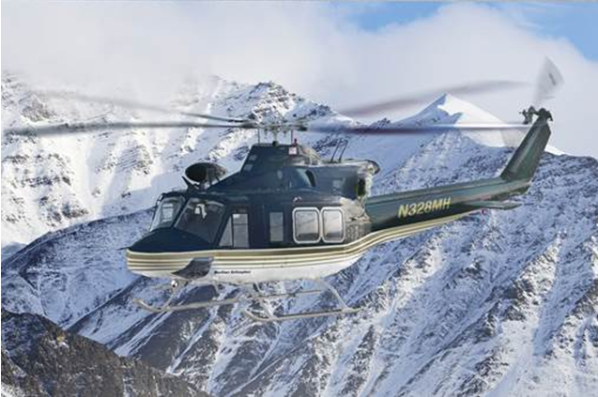
INITIAL TRAINING PROGRAM
MARITIME HELICOPTERS TRAINING
END OF PRESENTATION
Thank you

