Slide 1
Suspected Unapproved Parts
Why should I worry
&
What can I do
Notes:
Introduction
For the next hour we’ll see some reasons why we as mechanics, repairmen, owners operators, distributors, brokers or what ever function you fill in aviation should be concerned with SUSPECTED OR UNAPPROVED PARTS. We’ll also see what You can do to stop them from entering into the aviation system on a global level.

Slide 2
What will we talk about?
3 type of parts in the aviation system
Why should we worry about SUP’s
What kind of parts are being found
Where do they come from
What is the solution to stopping them
What can WE do about them
Who can we count on to resolve this problem
What publications can help us

Slide 3
We have to deal with 3 types of parts
Approved,
Unapproved,
or
Suspected Unapproved?

Slide 4
WHAT IS AN “APPROVED PART?”
“Approved part” is a part that has been:
Properly Designed
Properly Produced
Properly Maintained
Properly Documented
Task Force Report 3-3
Notes:
An Approved part or material must meet four requirements:
Properly Designed (Part 21.31)
Properly Produced I/A/W Part 21
Properly Maintained I/A./W Parts 43& 91
and Properly Documented to indicate Airworthiness

Slide 5
“APPROVED PART”
The term “approved part,” in quotations, is a colloquial term that means a part that has been designed & produced in accordance with Part 21, maintained in accordance with Parts 43 and 91, and meets applicable design standards, and is in a condition for safe operation and has documents to show this.
A.C. 21-29B Par 4
Notes:
Read Slide

Slide 6
WHAT IS AN UNAPPROVED PART?
An unapproved part is a part or material that does not meet any ONE (1) of the 4 requirements of an “Approved Part.”
Approved Design
Properly Produced
Properly Maintained
Properly Documented
Notes:
An unapproved part is a part or material that does not meet any ONE (1) of the 4 requirements of an “Approved Part.”
Not of an approved design
Not properly produced
Not properly maintained
Not properly documented

Slide 7
THEN WHAT IS A SUSPECTED UNAPPROVED PART?

Slide 8
SUSPECTED UNAPPROVED PART
A Suspected Unapproved Part, a “SUP”, is a part, component, or material that is suspected of not meeting the requirements of an “approved part.” A part that, for any reason, YOU suspect may not be “approved.”
Indicators of SUPs have included: a different finish, size, color, improper (or lack of) identification, incomplete or altered documentation and many others.
AC 21-29 Par 4
Notes:
A Suspected Unapproved Part, a “SUP”, is a part, component, or material that is suspected of not meeting the requirements of an “approved part.” A part that, for any reason, YOU suspect may not be “approved.”
Indicators of SUPs have included: a different finish, size, color, improper (or lack of) identification, incomplete or altered documentation and many others.

Slide 9
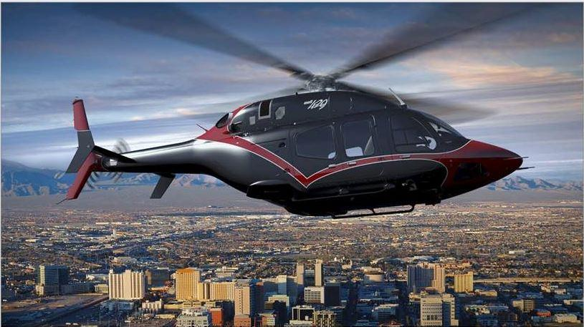
IS A SUP AN UNSAFE PART?
The problem is - we don’t know.
It could take Costly & Extensive testing and evaluation to make this determination.
Notes:
To make the determination could be a Costly Process. It could cost more then it would be to purchase an Approved Part for safety purposes. If you decided to install an unapproved part it could be very costly to you and your customer.

Slide 10
Suspected Unapproved Parts
Why should I worry?
Notes:
Why should you worry about Unapproved Parts from entering into the system?
The video depicted here is from an actual (Smoking Hole) accident investigation which resulted in fatalities.
This could ruin your whole day as well as the people involved

Slide 11
Why should I worry?
Loss of Life
Flight Safety
Structural/Operational Integrity
Manufacturer’s/Operator’s, Repair Stations And Your Reputations
Lost Customers & Future Business
Recall Costs
Rework Costs
Down Time
Legal Action
Notes:
YOU SHOULD BE CONCERNED ABOUT:
Loss of Life should be your First Concern Followed by:
Flight Safety of the passengers, Flight Crew, as well as people on the ground
Structural/Operational Integrity to allow Safe Operation
The Reputations of every one involved with the maintenance ad operation of the aircraft
Lost customers weather they are fling public or aircraft owners / operators
Cost of recalling the product to change the parts
Cost of the parts and labor involved to return the product to it’s Type Design I/A/W FAR 21.31
Cost of down time and lost revenue to return the product to it’s Type Design I/A/W FAR 21.31
And Last but not Least Legal Costs as a result of Law Suits, Defense costs or recovery of loss of use
Any one (1) of these can put you OUT OF BUSINESS

Slide 12
SUP FACTS
The airworthiness of aeronautical products is in question if:
The design, manufacture, repair and or quality of the parts and documents are unknown.
Number of SUP Cases from 1995 to 2000 = 1860
Number of Cases with Unapproved Parts = 478
Notes:
The facts seen on this slide speak for themselves. These numbers can actually be accredited to you people who reported the unapproved parts to gain these results. This is a great start but we need to continue the process for aviation safety.
Remember this is YOUR INDUSTRY, Fight to keep it Safe and honest. If you don’t it may continue for a long time or result in the Smoking Hole we seen a few slides ago.

Slide 13
SUP FACTS
There are people and facilities who are using you and your Certificates as a way to make a living by introducing Unapproved Parts into the aviation system.
When YOU accept and install these parts YOU have taken on the responsibility for the Airworthiness of the Parts and Products involved.
Notes:
These are actually FACTS. The slide you just seen with over 500 indictments and 256 convictions are a good indicator that there are people who want to make money off your certificates and hard work. Lets get those people out of aviation and make it a safer industry to work in.

Slide 14
What kind of parts are being found?
Lets look at a small sample of Unapproved parts we are finding in the aviation system as we speak.
Most of these parts were already into the system and installed or in the process of being installed when found.

Slide 15
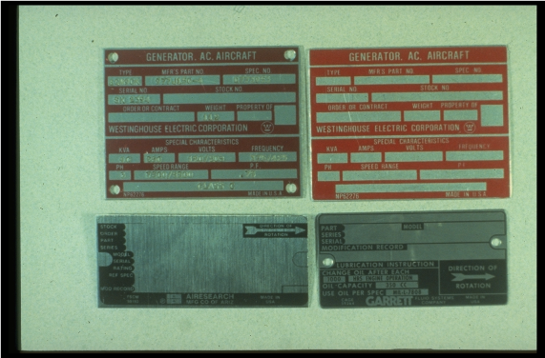
Counterfeit identification plates
APPROVED
UNAPPROVED
UNAPPROVED
APPROVED

Slide 16
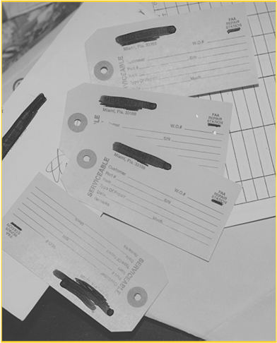
Counterfeit yellow tags
COUNTERFEIT YELLOW TAGS, REQUEST A COPY OF WORK ORDER AS REFERENCED ON THE TAG
Notes:
During a Search Warrant execution there were 7,000 Counterfeit Yellow Tags recovered using different Repair Station Certificate Numbers. It is Highly Recommended that you request a copy of the work order as referred to on the back of the yellow tag which should give you a complete description of the work completed during the repair. This will also ensure the facility listed on the yellow tag had done the work.

Slide 17
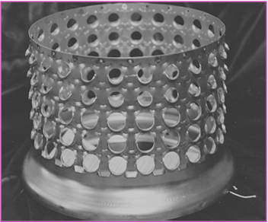
Counterfeit combustion liners
COUNTERFEIT WITH A LIFESPAN FROM 110 - 125 HOURS OF OPERATION

Slide 18
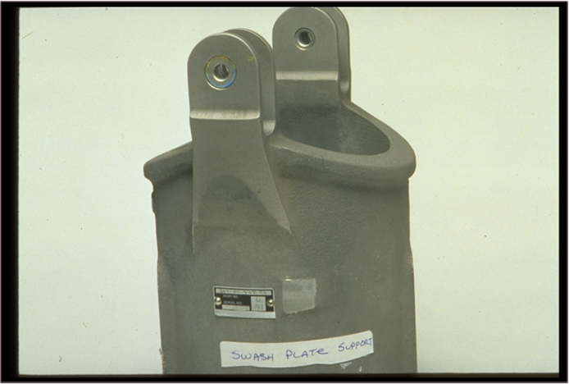
Counterfeit Swash plate support
PARTS SHOULD FIT WITHOUT ANY ADJUSTMENTS
COUNTERFEIT INCLUDING THE ID PLATE
Notes:
The installing mechanic was instructed by the seller to heat the mounting points to get meet the requirements for installation.
The parts should fit without any adjustments such as this.

Slide 19
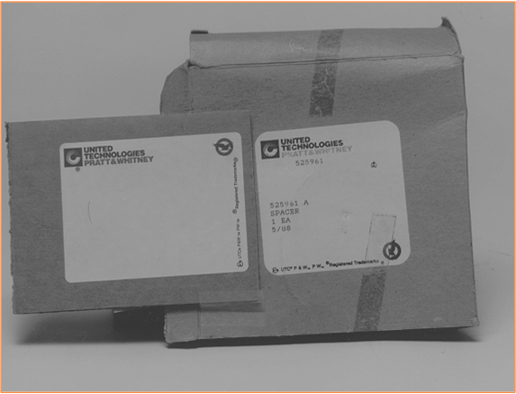
Counterfeit logos
LOGO PRINTED WRONG ON BOX

Slide 20
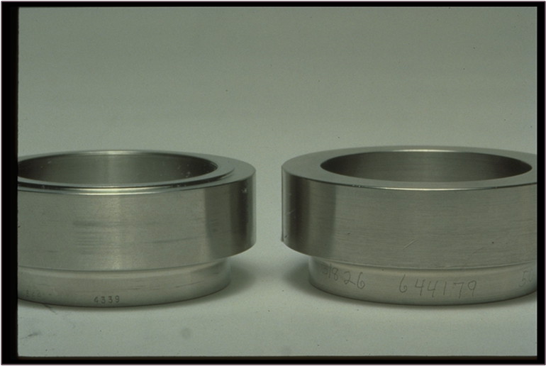
Bearing spacers
NO SHOULDER
VIBROETCHED MARKINGS

Slide 21
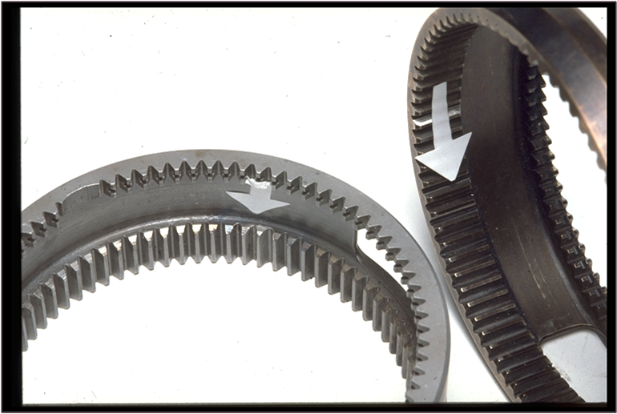
Gears made to look new again
UNAPPROVED REPAIRS THAT INCLUDED FILLING WITH WELD AND FILING THE TEETH TO PROFILE FOR SALE

Slide 22
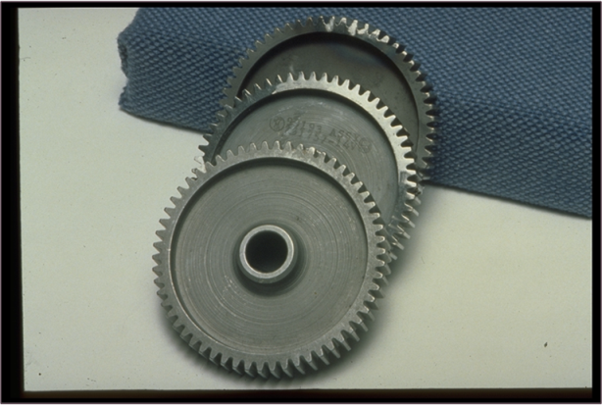
Unapproved repairs
Stage 1, WELD
Stage 2, FILE
Stage 3, SAND BLAST, MARK AND PREPARE FOR SHIPPING

Slide 23
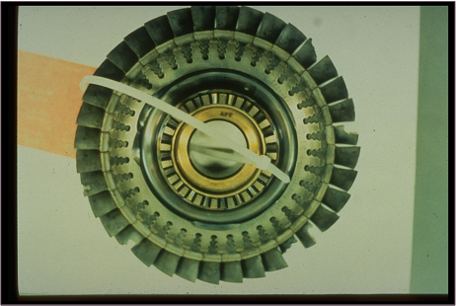
Life limited parts past limits
ACQUIRE THE LIFE HISTORY ON REQUIRED PARTS. BE CAREFUL OF CONTINUED TIMED PARTS WITH NO HISTORY OF LIFE REMAINING

Slide 24
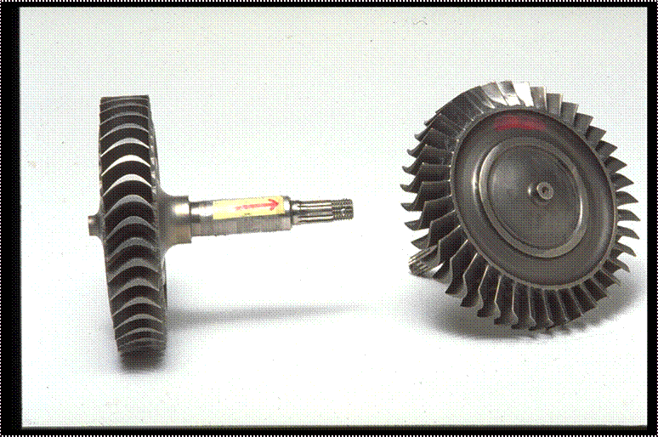
Turbine wheels
SOLD AS NEW WITH TWISTED SPLINE AND INSTRUCTIONS TO SEAT WITH HAMMER AND BLOCK OF WOOD.

Slide 25
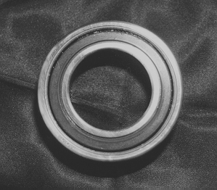
Unapproved Bearings
AUTOMOTIVE BEARINGS USED IN PLACE OF AVIATION QUALITY
GREASE SEAL MAY BE AN INDICATOR IN THE DIFFERENCE

Slide 26
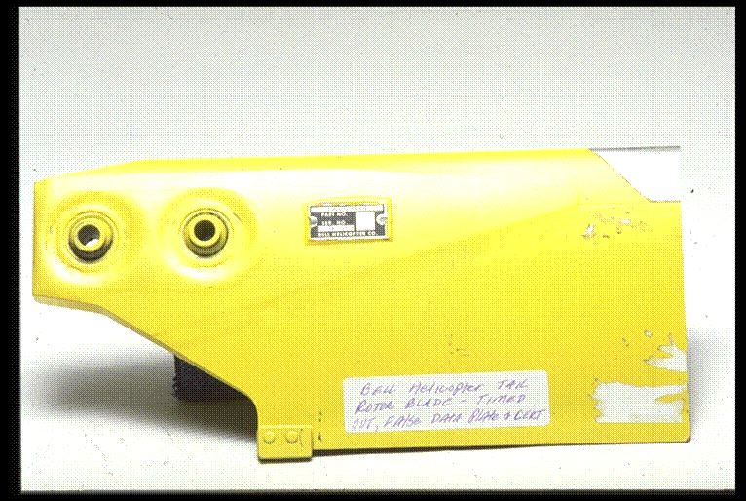
Making old parts look like new
EXPIRED LIFE ITEM WITH COUNTERFEIT DATA PLATE AND HISTORY CARD.

Slide 27
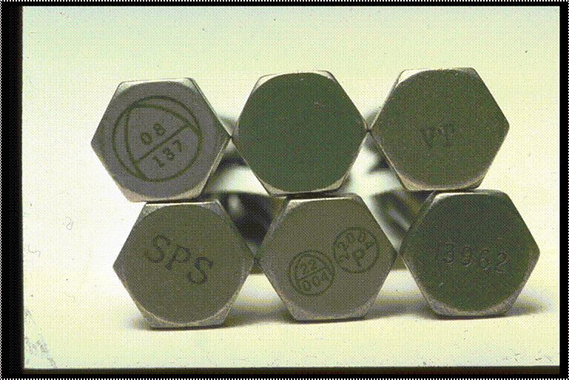
Standard hardware
EVEN STANDARD PARTS LIKE THESE ARE COUNTERFEITED
INSPECT BY USING THE STANDARD TO ENSURE CONFORMITY TO THE PUBLISHED STANDARD

Slide 28
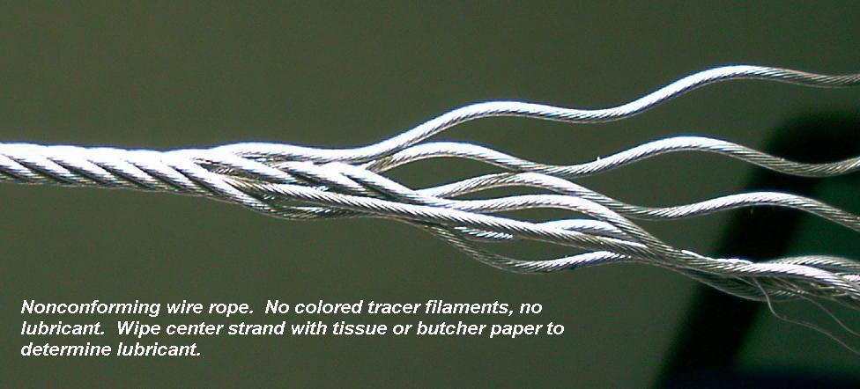
Non Conforming Cable (Wire Rope)

Slide 29
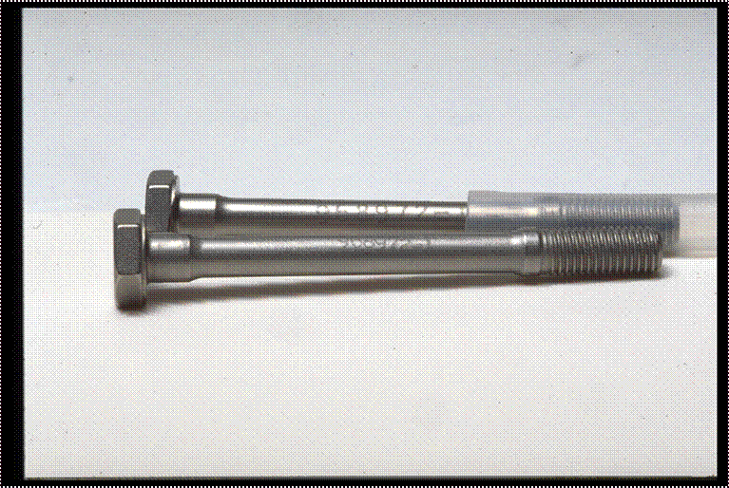
Special hardware
APPROVED
UNAPPROVED
FOUND BY MARKING DIFFERENCE. Look at the machine finish on the shoulder. This was undetected at the time of receiving inspection

Slide 30
Where do they come from?
AVR-20 maintains a data base where we store this information. We can retrieve any or all the information to determine where the parts are being found and who is placing them into the Global Aviation system.
Lets look at some of the information.

Slide 31
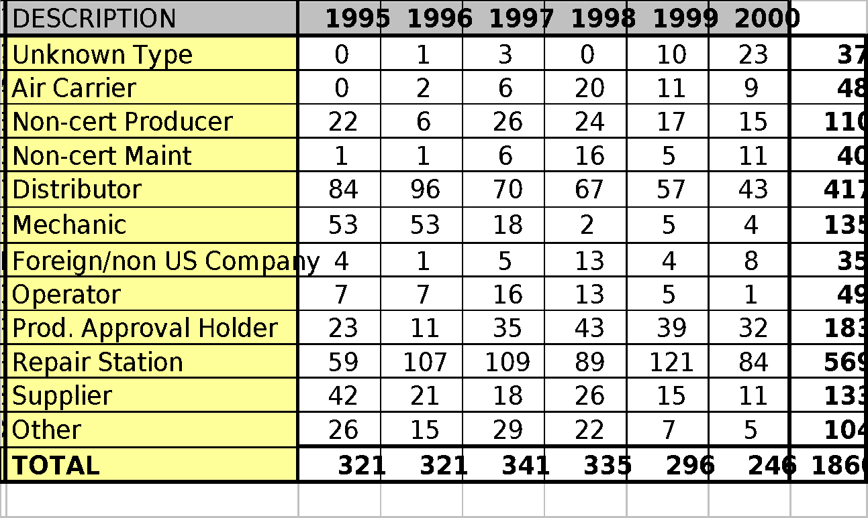
What are the Trends

Slide 32
What is the solution?
THE SOLUTION TO THE PROBLEM OF
SUSPECTED UNAPPROVED PARTS IS:
FOR EVERYONE TO WORK TOGETHER TO DETECT AND REMOVE THEM FROM THE GLOBAL AVIATION SYSTEM
MECHANICS, AUTHORIZED INSPECTORS, INDUSTRY, SUPPLIERS, DISTRIBUTORS, ASA, AFS, AIR, CAS, OIG, FBI, CUSTOMS, CAA’S, COAST GUARD, ETC.
Notes:
16
We must ALL WORK TOGETHER to solve the problem of Unapproved Parts that are in or entering into the aviation system.
Through the investigations completed so far it has been found that there are people who are using your certificates to make a living by passing Unapproved Parts through the system. They are making a living and if you install the parts YOU bear the responsibility. They don’t lose unless YOU take them out of the system.
Based on this it is time to set a defense to protect your Certificates, Reputations and Customers.

Slide 33
Set A Defense Against SUPs
We must all work together:
To promote the highest level of aviation safety by eliminating the potential safety risk posed by the entry of “unapproved parts” in the U.S. & Global aviation community.
Notes:
The industry as a whole should take an active role to Promote Aviation Safety on a Global basis. The first step is to eliminate the potential Safety Risk Posed by the entry and installation on Unapproved Parts and materials.

Slide 34

DETECTION & REMOVAL
IS A TEAM ACTIVITY
2
Notes:
2
NOTES:

Slide 35
SO WHAT CAN YOU DO
KNOW YOUR SUPPLIERS
ESTABLISH SUPPLIER SURVEILLANCE
ENSURE YOUR SUPPLIERS: ARE RATED, HAVE PROCEDURES, QUALIFIED PEOPLE AND A QUALITY SYSTEM
TRACK ACCEPTANCE DATA FOR REJECTS
ENHANCE TRAINING FOR RECEIVING & SUP AWARENESS

Slide 36
SO WHAT CAN YOU DO
ENHANCE ORDERING & RECEIVING INSPECTIONS AS A TEAM
INSPECT PARTS & DOCUMENTS FOR AIRWORTHINESS
REQUEST COPIES OF WORK ORDERS FOR YOUR RECORDS
SEGRATE QUESTIONABLE PARTS & MATERIALS

Slide 37
SO WHAT CAN YOU DO
MUTILATE YOUR UNSALVAGEABLE PARTS & MATERIALS
REPORT SUPS TO THE FAA

Slide 38
Who can help resolve the problem
Everyone working together can resolve the problem of UNSAFE parts in the aviation system.
What has the FAA done at this point?
We also have some help in the form of Law Enforcement Authorities and a NEW TOOL to help all of us fight back.

Slide 39
JOINT EFFORT
The FAA has made significant in-roads in addressing the unapproved parts issue with your help. This effort, however, has not been unilateral. Law enforcement agencies, as well as the aviation industry, have also been aggressively addressing unapproved parts sometimes resulting in frustration.

Slide 40
LAW ENFORCEMENT
Since 1993, federal law enforcement agencies have secured approximately 500 criminal indictments for the manufacture, distribution, or installation of unapproved parts. Most ended with short sentences and or fines.
So we have a NEW TOOL to assist us.

Slide 41
The New SUP Law
H.R. 1000
Wendell H. Ford Aviation Investment and Reform Act for the 21st Century

Slide 42
SUP Law: Offenses
  Sec. 38. Fraud involving aircraft or space vehicle parts in interstate or foreign commerce
(a) OFFENSES-
(1)(A) falsifies or conceals a material fact concerning any aircraft or space vehicle part;
(B) makes any materially fraudulent representation concerning any aircraft or space vehicle part; or
(C) makes or uses any materially false writing, entry, certification, document, record, data plate, label, or electronic communication concerning any aircraft or space vehicle part;

Slide 43
SUP Law: Offenses
(2) exports from or imports or introduces into the United States, sells, trades, installs on or in any aircraft or space vehicle any aircraft or space vehicle part using or by means of a fraudulent representation, document, record, certification, depiction, data plate, label, or electronic communication; or

Slide 44
SUP Law: Offenses
(3) attempts or conspires to commit an offense described in paragraph (1) or (2), shall be punished as provided in subsection (b)

Slide 45
SUP Law: Penalties
    (b) PENALTIES-
    (1) AVIATION QUALITY- If the offense relates to the aviation quality of a part and the part is installed in an aircraft or space vehicle, a fine of not more than $500,000, imprisonment for not more than 15 years, or both.

Slide 46
SUP Law: Penalties
(2) FAILURE TO OPERATE AS REPRESENTED - If, by reason of the failure of the part to operate as represented, the part to which the offense is related is the proximate cause of a malfunction or failure that results in serious bodily injury (as defined in section 1365), a fine of not more than $1,000,000, imprisonment for not more than 20 years, or both.

Slide 47
SUP Law: Penalties
(3) FAILURE RESULTING IN DEATH- If, by reason of the failure of the part to operate as represented, the part to which the offense is related is the proximate cause of a malfunction or failure that results in the death of any person, a fine of not more than $1,000,000, imprisonment for any term of years or life, or both.

Slide 48
SUP Law: Penalties (cont’d)
    (4) OTHER CIRCUMSTANCES- In the case of an offense under subsection (a) not described in paragraph (1), (2), or (3) of this subsection, a fine under this title, imprisonment for not more than 10 years, or both.

Slide 49
SUP Law: Penalties
    (5) ORGANIZATIONS- If the offense is committed by an organization, a fine of not more than--
        (A) $10,000,000 in the case of an offense described in paragraph (1) or (4); and
        (B) $20,000,000 in the case of an offense described in paragraph (2) or (3).

Slide 50
SUP Law: Civil Remedies
    (c) CIVIL REMEDIES-
      (1) IN GENERAL- The district courts of the United States shall have jurisdiction to prevent and restrain violations of this section by issuing appropriate orders, including--

Slide 51
SUP Law: Civil Remedies
(A) ordering a person (convicted of an offense under this section) to divest any interest, direct or indirect, in any enterprise used to commit or facilitate the commission of the offense, or to destroy, or to mutilate and sell as scrap, aircraft material or part inventories or stocks;

Slide 52
SUP Law: Civil Remedies
(B) imposing reasonable restrictions on the future activities or investments of any such person, including prohibiting engagement in the same type of endeavor as used to commit the offense; and

Slide 53
SUP Law: Civil Remedies
        (C) ordering the dissolution or reorganization of any enterprise knowingly used to commit or facilitate the commission of an offense under this section making due provisions for the rights and interests of innocent persons.

Slide 54
SUP Law: Criminal Forfeiture
    (d) CRIMINAL FORFEITURE-
      (1) IN GENERAL- The court, in imposing sentence on any person convicted of an offense under this section, shall order, in addition to any other sentence and irrespective of any provision of State law, that the person forfeit to the United States--

Slide 55
SUP Law: Criminal Forfeiture
(A) any property constituting, or derived from, any proceeds that the person obtained, directly or indirectly, as a result of the offense; and

Slide 56
SUP Law: Criminal Forfeiture
        (B) any property used, or intended to be used in any manner, to commit or facilitate the commission of the offense, if the court in its discretion so determines, taking into consideration the nature, scope, and proportionality of the use of the property on the offense.

Slide 57
RELATED PUBLICATIONS
A.C. 21-29B, Detecting and Reporting Suspected Unapproved Parts.
FAA Order 8120.10A, Suspected Unapproved Parts Program.

Slide 58
RELATED PUBLICATIONS
A.C. 00-56, Voluntary Industry Distributor Accreditation Program.
A.C. 20-62, Eligibility, Quality and Identification of Approved Aeronautical Replacement Parts.
A.C. 20-142, Eligibility and Evaluation of U.S. Military Surplus Flight Safety Critical Aircraft Parts, Engines, and Propellers.
A.C. 21-20, Supplier Surveillance Procedures.
A.C. 21-38, Disposition of Unsalvageable Aircraft Parts and Materials.

Slide 59
RELATED PUBLICATIONS
FAA Order 8120.2, Production Approval and Surveillance Procedures.
FAA Order 8130.2, Airworthiness Certification of Aircraft and Related Products.
FAA Order 8110.42, Parts Manufacturer Approvals Procedures.

Slide 60
THINGS TO REMEMBER
If you remember nothing else from today Please Remember this

Slide 61
PUBLIC CONSIDERATIONS:
WE ARE PROFESSIONALS THAT SHOULD BE WORKING TO PROVIDE A SAFE MODE OF TRANSPORTATION BASED ON OUR TRAINING AND EXPERIENCE. THIS IS PROJECTED TO THEM THROUGH OUR DECISIONS AND ACTIONS.
THEY TRUST US WITH THEIR LIVES AND, THE LIVES OF THEIR LOVED ONES EVERYDAY BY CHOOSING TO FLY.
STAND UP TO THAT TRUST, THIS IS YOUR INDUSTRY, HELP TO KEEP IT SAFE.

Slide 62
THE WORK YOU DO, AND THE DECISIONS YOU MAKE EVERYDAY, IMPACTS THOUSANDS OF LIVES
MAKE EVERYDAY A SAFE ONE
SUSPECT,
INVESTIGATE;
AVIATION SAFETY
DEPENDS ON
YOU !!!

Slide 63
TASK FORCE HOTLINES
Email 9-AWA-AVR20-SUPS@FAA.GOV
AVS Safety Hotline 1-800-555-1111
Notes:
9
11
11
The recommendation of the Task Force included creating an organizational structure that would provide:
Clear and consistent guidance
enhance training(regarding SUPs)
more timely Sup case processing
access to usable management information system data.
and promote close interaction with other law enforcement agencies in eliminating SUP.
The organization is AVR-20...

Slide 64
THE END
Thank you for your attention.
Please click
HERE
to go to exam.
Notes:
9
11
11
The recommendation of the Task Force included creating an organizational structure that would provide:
Clear and consistent guidance
enhance training(regarding SUPs)
more timely Sup case processing
access to usable management information system data.
and promote close interaction with other law enforcement agencies in eliminating SUP.
The organization is AVR-20...

